Slide 1

Covid-19: An Analysis of Herd Immunity
By: Stephen Fong

Slide 2
Background and Motivation
Covid vaccinations are important, and it remains uncertain how long it will take until we reach a vaccinated population large enough to slow the progression of covid-19.
An analysis of the number of covid-19 vaccinations for the United States would be useful to predict the amount of time before herd immunity can be reached
Questions to be answered in this project includes:
How many individuals must be vaccinated in the United States?
How long until herd immunity is reached?
When will the world expect some level of normalcy?

Slide 3
Python Tools
Modules
Numpy - analysis
Pandas – dataframe, analysis
Matplotlib - plotting

Slide 4

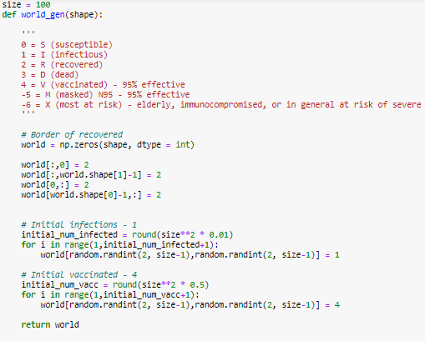
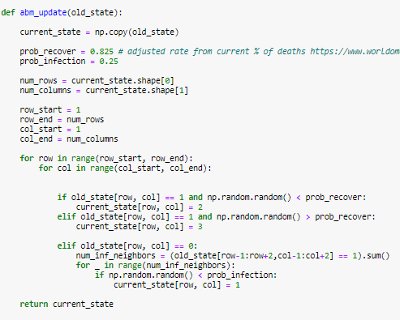
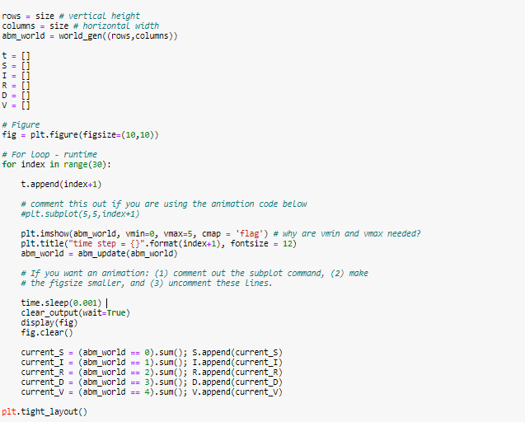
Methodology
This project used agent-based modeling (ABM)
Herd immunity based on the percentage of the vaccinated populace
Expand the SIR model to include deaths and vaccinations to measure effect on herd immunity
Function 1 – generates initial board
Function 2 – updates old board based
on conditional statements
For loop containing the progressing boards

Slide 5
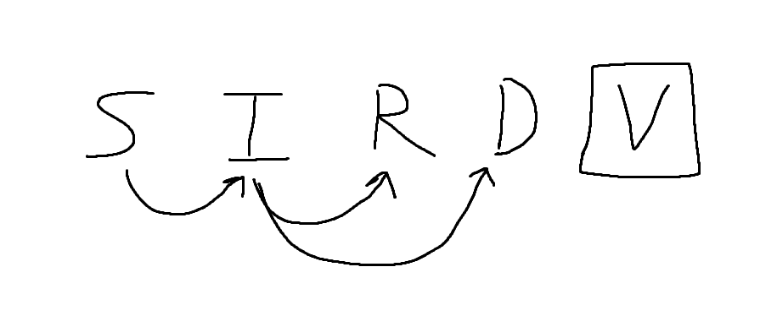
In addition to the SIR model (values: 0 - 2), are values:
D (Death) - value of 3
V (Vaccincated) – value of 4
Schema showing connection between different states
Function 1 – generates initial board
Function 2 – updates old board based
on conditional statements
For loop containing the progressing

Slide 6
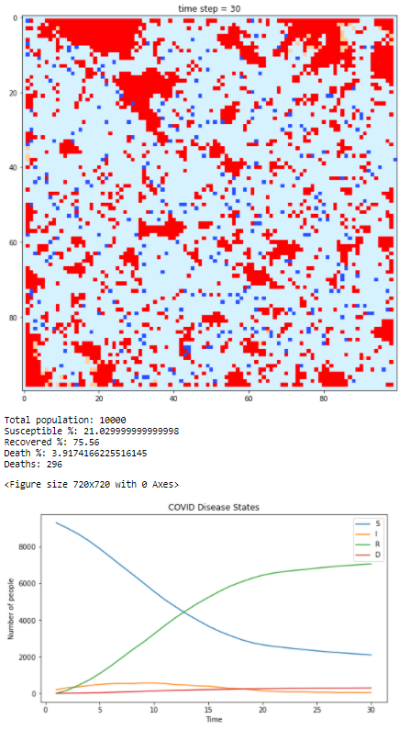
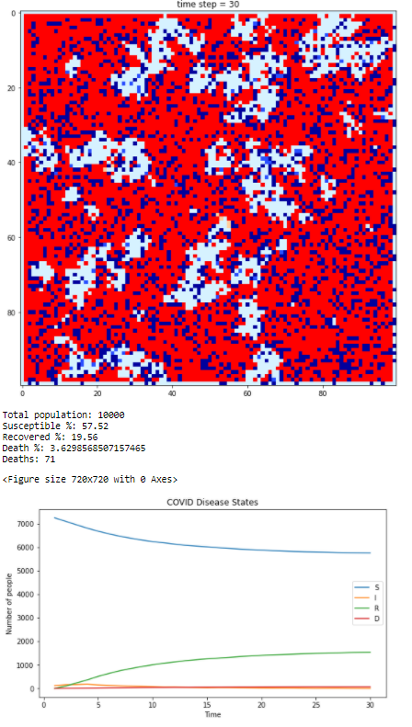
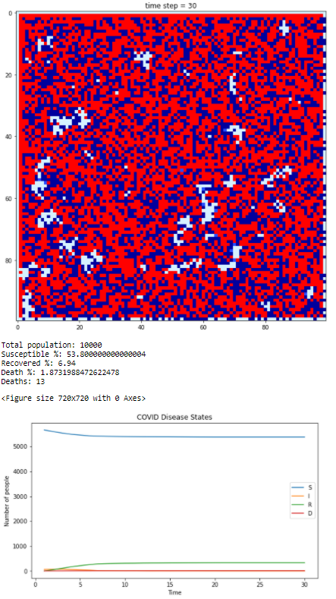
Results
Initial condition: No vaccinations
25% Vaccinated
50% Vaccinated
Deaths if everyone in the US was infected:
9.77 million deaths
~3% of US pop.
2.34 million deaths
0.71% of US pop.
429,000 deaths
0.13% of US pop.

Slide 7
Synthesis and Discussion
Findings:
Vaccinations help slow down and prevent the spread of disease
As seen in the previous slide, there were fewer deaths, and a slower rise of infection in the vaccinated plots compared to the initial plot with zero vaccinations
Limitations:
This model does not completely model the world because the squares on the board are static
Humans move around, and interact with different communities, which can further the spread of disease. (therefore, social distancing is important)
Further study:
It may be of interest to include other forms of protection such as masks. social distancing, and handwashing in the model.

Slide 8
Questions to be answered in this project includes:
How many individuals must be vaccinated in the United States?
Herd immunity can help the 20-30% of the population that is at risk for severe complications due to Covid-19.
Considering this, at least 70% of the population should be vaccinated to protect the 20-30% of the severely at-risk population
How long until herd immunity is reached?
In the last three weeks, an additional 10% of the US population has become completely vaccinated.
As of 4/19/21, the US is 25.7% fully vaccinated, to reach at least 70%, it will take around ~13.3 weeks, or 3.1 months. This is assuming the number of vaccines produced and the number of people getting vaccinated is constant.
When will the world expect some level of normalcy?
After 3-4+ months, we can expect some level of normalcy, but still not walking around without a mask kind of normal.

Slide 9
References
HW #5 Code
Preda, Gabriel. “COVID-19 World Vaccination Progress.” Kaggle, 17 Apr. 2021, www.kaggle.com/gpreda/covid-world-vaccination-progress.
Owid. “Owid/Covid-19-Data.” GitHub, 17 Apr. 2021, github.com/owid/covid-19-data/blob/master/public/data/vaccinations/country_data/United%20States.csv.
“Coronavirus Immunity.” University of Maryland Medical System, www.umms.org/coronavirus/covid-vaccine/facts/immunity.

